Slide 1
AI Application Problem
(bi_ReLU_sbo)
• Single Proton Emission Computed Tomography (SPECT)
heart diagnosis data set (Kurgan, et al., 2001; UCI Machine Learning)
• 267 instances (55 normal samples, and 212 abnormal samples)
• Positive: normal
Negative: abnormal
Training data set | Amount of positive samples | 40
 | Amount of negative samples | 40
Testing data set | Amount of positive samples | 15
 | Amount of negative samples | 172
Total amount of samples |  | 267
• 23 attributes
(x: 22 (binary) attributes,
y: 1 (binary) attribute)
• y: Binary (normal: 0, abnormal: 1)
1

Slide 2
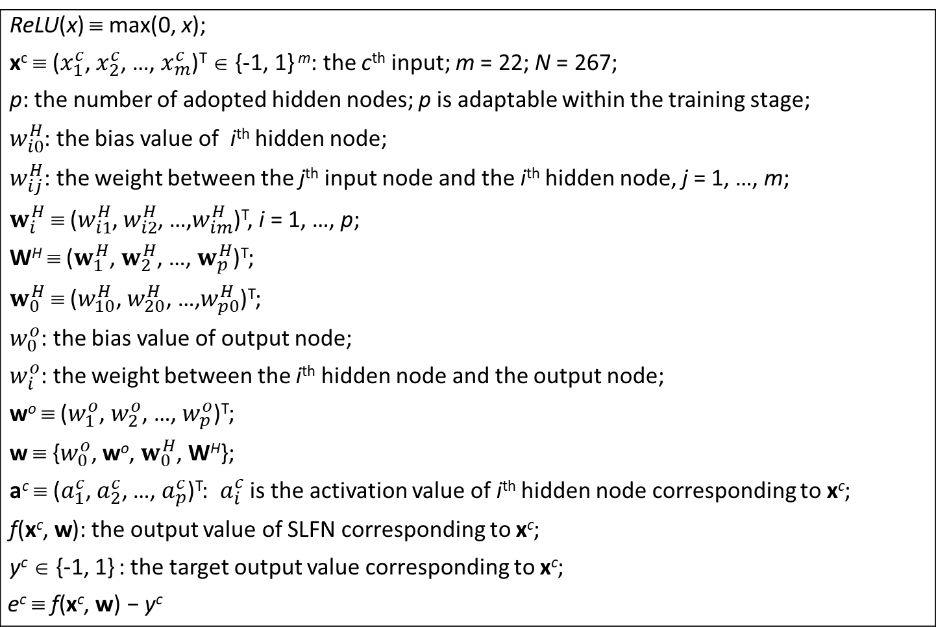
Assumption: the adaptive network
The network setting:
Two-layer nets / SLFN / One-hidden-layer nets
ReLU(x) ≡ max(0, x); x^{c} ≡ ($x_{1}^{c}$, $x_{2}^{c}$, …, $x_{m}^{c}$)^{T} ∈ {-1, 1} ^{m}: the c^{th} input; m = 22; N = 267; p: the number of adopted hidden nodes; p is adaptable within the training stage; $w_{i0}^{H}$: the bias value of i^{th} hidden node; $w_{ij}^{H}$: the weight between the j^{th} input node and the i^{th} hidden node, j = 1, …, m; $w_{i}^{H}$ ≡ ($w_{i1}^{H}$, $w_{i2}^{H}$, …,$w_{im}^{H}$)^{T}, i = 1, …, p; W^{H} ≡ ($w_{1}^{H}$, $w_{2}^{H}$, …, $w_{p}^{H}$)^{T}; $w_{0}^{H}$ ≡ ($w_{10}^{H}$, $w_{20}^{H}$, …,$w_{p0}^{H}$)^{T}; $w_{0}^{o}$: the bias value of output node; $w_{i}^{o}$: the weight between the i^{th} hidden node and the output node; wº ≡ ($w_{1}^{o}$, $w_{2}^{o}$, …, $w_{p}^{o}$)^{T}; w ≡ {$w_{0}^{o}$, wº, $w_{0}^{H}$, W^{H}}; a^{c} ≡ ($a_{1}^{c}$,${ a}_{2}^{c}$, …, $a_{p}^{c}$)^{T}: $a_{i}^{c}$ is the activation value of i^{th} hidden node corresponding to x^{c}; f(x^{c},$\text{w}$): the output value of SLFN corresponding to x^{c}; y^{c} ∈ {-1, 1} : the target output value corresponding to x^{c}; $$\text{e}\text{c} \text{≡ }\text{f}\text{(}\text{x}\text{c}\text{,} \text{w}\text{)}\text{ − }\text{y}\text{c}$$
2

Slide 3

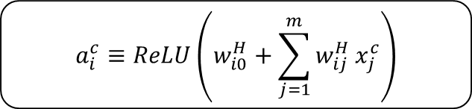



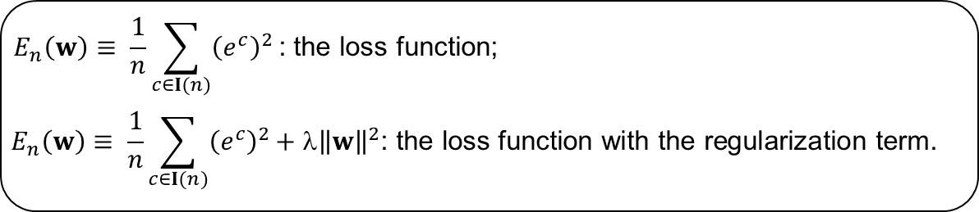
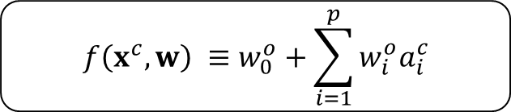
The forward operation setting
Forward operation
Hidden Layer
The hidden layer:
i
$$a_{i}^{c}≡\operatorname{ReLU}\left(w_{i0}^{H}+\sum_{j=1}^{m}{w_{ij}^{H}}x_{j}^{c}\right)$$
Input Layer
$$x_{1}$$
$$x_{2}$$
$$x_{3}$$
…
$$x_{m}$$
Output Layer
1
The output layer:
$$f\left(x^{c},w\right) ≡w_{0}^{o}+\sum_{i=1}^{p}{w_{i}^{o}a_{i}^{c}}$$
Hidden Layer
1
2
…
p
$$E_{n}\left(w\right)≡ \frac{1}{n}\sum_{c∈I(n)}{{\left(e^{c}\right)}^{2}}\text{: }\text{the} \text{loss} \text{function}\text{;}$$
$$E_{n}\left(w\right)≡ \frac{1}{n}\sum_{c∈I(n)}{{\left(e^{c}\right)}^{2}}\text{+ }\text{λ}{\left\|w\right\|}^{2}\text{: }\text{the} \text{loss} \text{function} \text{with} \text{the} \text{regularization} \text{term}\text{.}$$
Notes:
The Single-hidden layer Feedforward Neural Networks (SLFN) structure

Slide 4


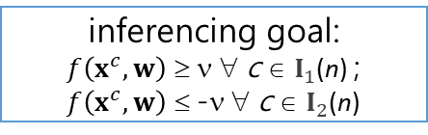



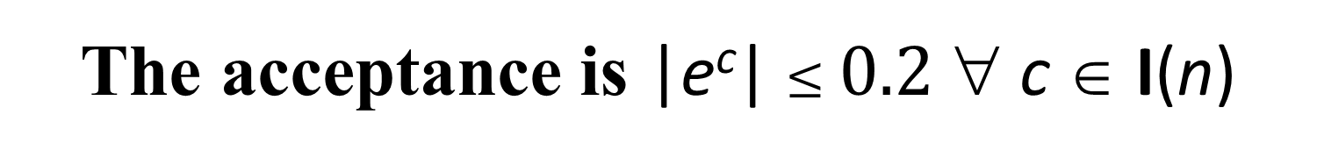

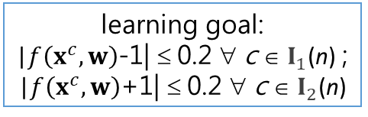
The learning goal of the n^{th} stage
y^{c} = 1 $∀ c∈I_{1}$(n); y^{c} = -1 $∀ c∈I_{2}$(n);$I$(n) ≡ $I_{1}$(n) ∪ $I_{2}$(n)
learning goal:
|$f\left(x^{c},w\right)$-1| ≤ 0.2 ∀ c ∈ $I_{1}$(n) ;
|$f\left(x^{c},w\right)$+1| ≤ 0.2 ∀ c ∈ $I_{2}$(n)
$$−1$$
1
o
o
o
x
o
x
x
x
$$f\left(x^{c},w\right)$$
|e^{c}| $≤\text{0.2}$ ∀ c
Undecided
$$−v$$
$v$=0.8
inferencing goal:
$f\left(x^{c},w\right)$ ≥ ν ∀ c ∈ $I_{1}$(n) ; $f\left(x^{c},w\right)$ ≤ -ν ∀ c ∈ $I_{2}$(n)
o
o
o
o
x
x
x
x
$$f\left(x^{c},w\right)$$
Undecided
The acceptance is |e^{c}| $≤\text{0.2}$ ∀ c ∈ I(n)

Slide 5
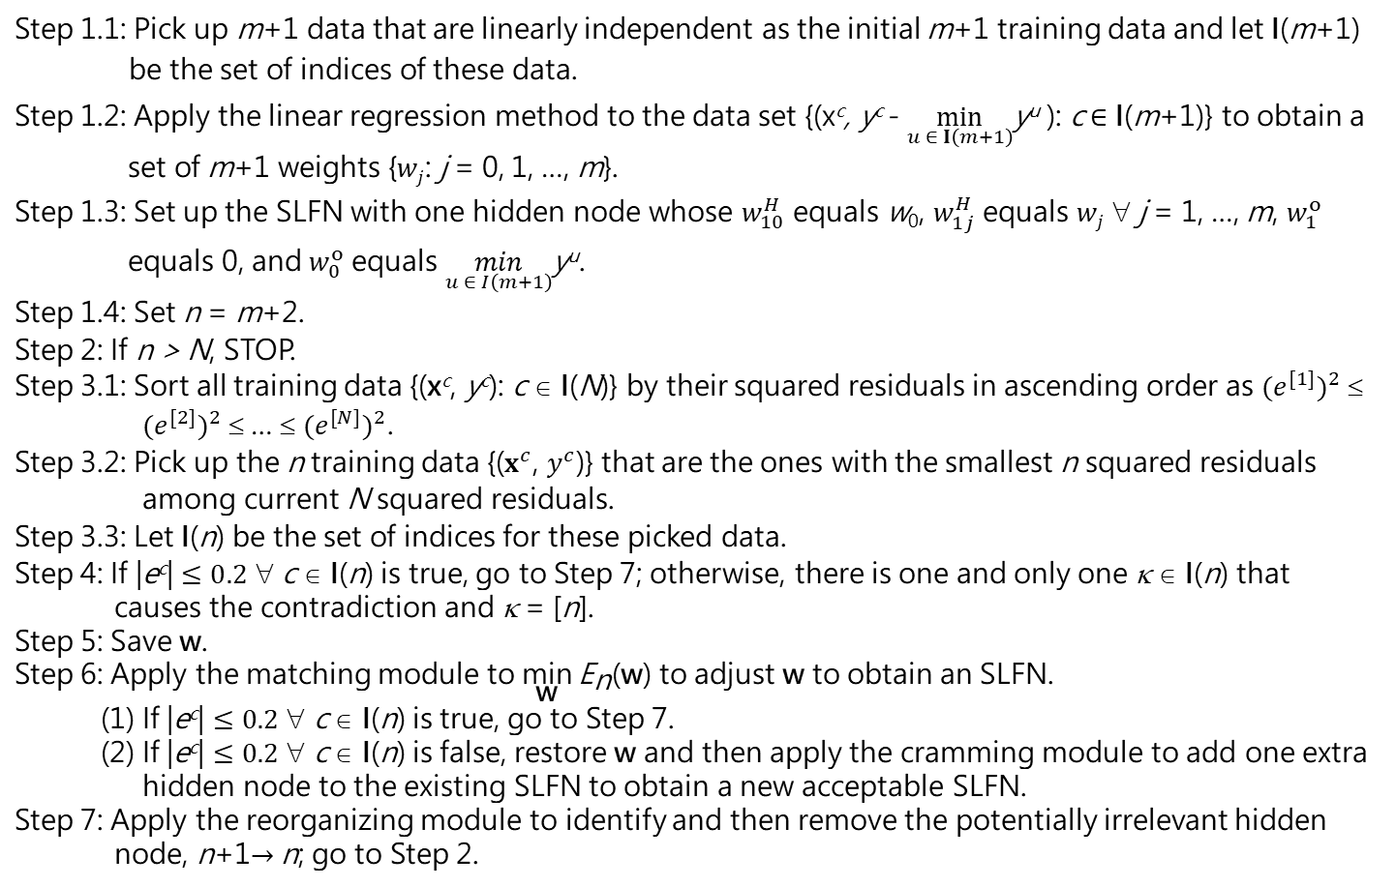
The proposed learning algorithm
Step 1.1: Pick up m+1 data that are linearly independent as the initial m+1 training data and let I(m+1) be the set of indices of these data. Step 1.2: Apply the linear regression method to the data set {(x^{c}, y^{c} - $\min_{u ∈ I\left(m+1\right)}$y^{u} ): c ∈ I(m+1)} to obtain a set of m+1 weights {$wj$: j = 0, 1, …, m}. Step 1.3: Set up the SLFN with one hidden node whose $w_{10}^{H}$ equals w₀, $w_{1j}^{H}$ equals $wj$ ∀ j = 1, …, m, $w_{1}^{o}$ equals 0, and $w_{0}^{o}$ equals $\min_{u ∈ I\left(m+1\right)}$y^{u}. Step 1.4: Set n = m+2. Step 2: If n > N, STOP. Step 3.1: Sort all training data {(x^{c}, y^{c}): c ∈ I(N)} by their squared residuals in ascending order as ${(e^{[1]})}^{2}$ ≤ ${(e^{[2]})}^{2}$ ≤ … ≤ ${(e^{[N]})}^{2}$. Step 3.2: Pick up the n training data {($x^{c}$, $y^{c}$)} that are the ones with the smallest n squared residuals among current N squared residuals. Step 3.3: Let I(n) be the set of indices for these picked data. Step 4: If |e^{c}| $≤0.2$ ∀ c ∈ I(n) is true, go to Step 7; otherwise, there is one and only one κ ∈ I(n) that causes the contradiction and κ = [n]. Step 5: Save w. Step 6: Apply the matching module to $\underset{\text{w}}{\text{min}}{{\text{E}}_{\text{n}}\text{(}\text{w}\text{)}}$ to adjust w to obtain an SLFN. (1) If |e^{c}| $≤0.2$ ∀ c ∈ I(n) is true, go to Step 7. (2) If |e^{c}| $≤0.2$ ∀ c ∈ I(n) is false, restore w and then apply the cramming module to add one extra hidden node to the existing SLFN to obtain a new acceptable SLFN. Step 7: Apply the reorganizing module to identify and then remove the potentially irrelevant hidden node, n+1$→$n; go to Step 2.

Slide 6
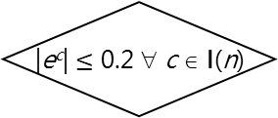
The proposed learning algorithm
(in flowchart)
True
n ≥ N
False
Selecting
|e^{c}| $≤\text{0.2}$ ∀ c ∈ I(n)
False
Save w
True
Matching
A
n ++
Reorganizing
Cramming
Restore w
B
Initializing
6

Slide 7

The initializing module
Step 1: Pick up m+1 data that are linearly independent as the initial m+1 training data and let I(m+1) be the set of indices of these data.
Step 2: Apply the linear regression method to the data set {(x^{c}, y^{c} - $\min_{u ∈ I\left(m+1\right)}$y^{u}), c ∈ I(m + 1)} to obtain a set of m + 1 weights {$wj$, j = 0, 1, …, m}.
Step 3: Set up the SLFN with one hidden node whose $w_{10}^{H}$ equals w₀, $w_{1j}^{H}$ equals $wj$ ∀ j = 1, …, m, $w_{1}^{o}$ equals 1, and $w_{0}^{o}$ equals $\min_{u ∈ I\left(m+1\right)}$y^{u}.
Step 4: Set n = m+2.
In Step 2, the corresponding set of simultaneous linear equations is a system of m + 1 linear equations in m + 1 unknowns:
w₀ + $\sum_{j=1}^{m}{wj{ x}_{j}^{c}}=$ y^{c} - $\min_{u∈ I\left(m+1\right)}$y^{u} ∀ c ∈ I(m + 1)
This setup of SLFN renders (e^{c})² = 0 ∀ c ∈ I(m + 1)

Slide 8

The selecting module with LTS
The stopping criterion
If n > N, STOP.
At the n^{th} stage,
Step 1: Sort all N training data based upon the squared residual (e^{c})² values.
Step 2: Select the n training data {($x^{c}$, $y^{c}$)} that are the ones with the smallest n squared residuals among current N squared residuals.
Step 3: Let I(n) be the set of indices of these data.

Slide 9
The learning goal
|e^{c}| $≤\text{0.2}$ ∀ c ∈ I(n)
The save module
Save w
The restore module
Restore the saved w

Slide 10

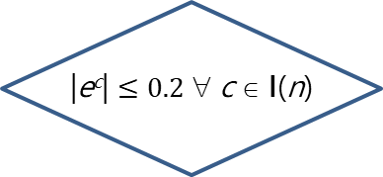
The matching module
Hyperparameters:
100
Optimizer (Adam)
ε = 0.2
$$E_{n}\left(w\right)≡\frac{\sum_{c}{{\left(f\left(x^{c},w\right)−y^{c}\right)}^{2}}}{n}$$
i = 1
i++
forward
operation
False
i ≥ 100
|e^{c}| $≤0.2$ ∀ c ∈ I(n)
backward operation
False
True
True
B
Unacceptable net
Acceptable net
A

Slide 11


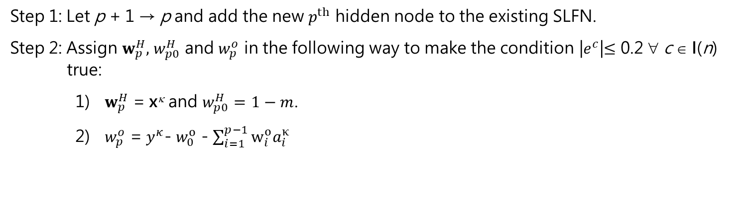
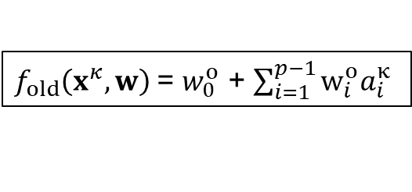

The cramming module
Step 1: Let p + 1 → p and add the new $p^{th}$ hidden node to the existing SLFN.
Step 2: Assign $w_{p}^{H},$ $w_{p0}^{H}$ and $w_{p}^{o}$ in the following way to make the condition |$e^{c}$|$≤$ 0.2 ∀ c ∈ $\text{I}\text{(}\text{n}\text{)}$ true:
${ w}_{p}^{H}$ = x^{κ} and $w_{p0}^{H}=1−m$.
${ w}_{p}^{o}$ = $y^{κ}$- $w_{0}^{o}$ - $\sum_{i=1}^{p−1}{w_{i}^{o}a_{i}^{κ}}$
1
$f_{old}\left(x^{κ},w\right)$= $w_{0}^{o}$ + $\sum_{i=1}^{p−1}{w_{i}^{o}a_{i}^{κ}}$
$$w_{p}^{o}={y^{κ}−f}_{old}\left(x^{κ},w\right)$$
1
2
3
…
p
$w_{p0}^{H}$ = $1−m$
$w_{pj }^{H}$= $x_{j}^{κ}$ $∀ j$
1
2
……
m

Slide 12


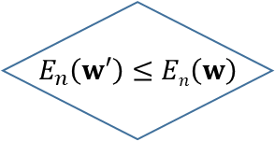
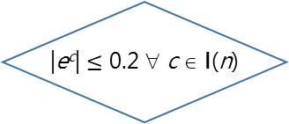
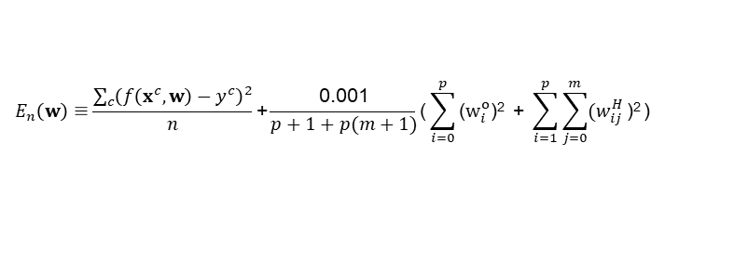

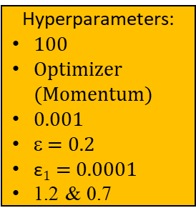
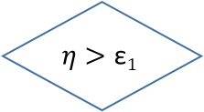

$$E_{n}\left(w\right)≡\frac{\sum_{c}{{\left(f\left(x^{c},w\right)−y^{c}\right)}^{2}}}{n}\text{+}\frac{\text{0.001}}{p+1+p(m+1)}\text{(}\sum_{i=0}^{p}{\text{(}w_{i}^{o}\text{)}\text{2}}\text{ + }\sum_{i=1}^{p}{\sum_{j=0}^{m}{{(w}_{ij}^{H}}\text{)}\text{2}}\text{)}$$
The regularizing module
An acceptable net that accomplishes the learning goal
$$η$$
i = 1
An acceptable net that has a preference on weights
True
i ≥ 100
False
Store w
Hyperparameters:
100
Optimizer (Momentum)
0.001
ε = 0.2
$\text{ε}1$ = 0.0001
1.2 & 0.7
backward operation to obtain $w′$
$w^{′}→w$ $$1.2 η→η$$
i+1 $→$ i
forward operation
Restore w
& $0.7η→η$
$$E_{n}\left(w′\right)≤En\left(w\right)$$
|e^{c}| $≤\text{0.2}$ ∀ c ∈ I(n)
True
True
False
False
True
$$η>\text{ε}1$$
An acceptable net that has a preference on weights
False
Restore w

Slide 13
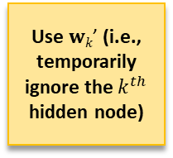
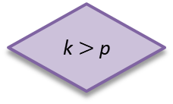
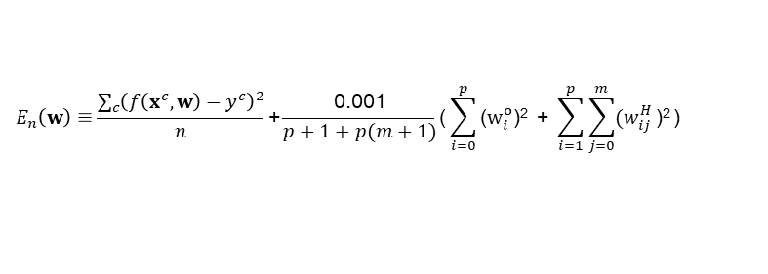
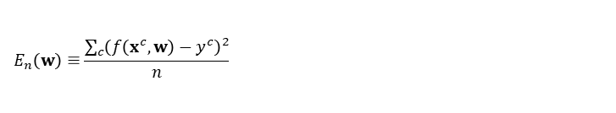

The reorganizing module
$$E_{n}\left(w\right)≡\frac{\sum_{c}{{\left(f\left(x^{c},w\right)−y^{c}\right)}^{2}}}{n}$$
$$E_{n}\left(w\right)≡\frac{\sum_{c}{{\left(f\left(x^{c},w\right)−y^{c}\right)}^{2}}}{n}\text{+}\frac{\text{0.001}}{p+1+p(m+1)}\text{(}\sum_{i=0}^{p}{\text{(}w_{i}^{o}\text{)}\text{2}}\text{ + }\sum_{i=1}^{p}{\sum_{j=0}^{m}{{(w}_{ij}^{H}}\text{)}\text{2}}\text{)}$$
Restore the network and w
Hyperparameters:
100
Two optimizers (Momentum & Adam)
0.001
Two sets of ε & $\text{ε}1$
(ε = 0.2; $\text{ε}1$ = 0.0001)
Two sets of 1.2 & 0.7
k ++
p --
A
B
An acceptable SLFN
k $>$p
regularizing
Use $wk\text{’}$ (i.e., temporarily ignore the $k^{th}$ hidden node)
matching
k = 1
False
Store the network and w
True
An acceptable SLFN
Different loss functions!

